Slide 1
Amazon Reviews Sentiment Analysis
Group 80
NGUYỄN VĂN HUÂN
NGUYỄN VĂN HUẤN
NGUYỄN VĂN HUY 186300
NGUYỄN VĂN HUY
NGUYỄN VĂN THANH

Slide 2
AGENDA
1. Problem Definition
2. Data Collection
3. Data Preprocessing
4. Word Embedding
5. Splitting Data
6. Model Building
7. Model Training
8. Model Evaluation
9. QA

Slide 3
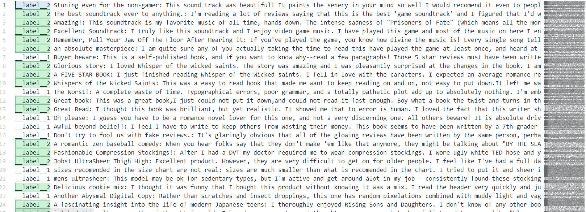
1. Problem Definition
The task: Sentiment analysis
The target labels: __label__<X>, features: review <text>

Slide 4
2. Data Collection
A dataset of Amazon reviews
https://www.kaggle.com/datasets/bittlingmayer/amazonreviews

Slide 5
3. Data Preprocessing
Loading Data: Load data to pandas.DataFrame
Text Cleaning: Remove unnecessary characters, HTML tags, URLs, etc
Lowercasing: Convert all text to lowercase to ensure uniformity
Tokenization: Split text into words (tokens)
Stop Words Removal: Remove common words that not be useful for the task, use nltk ‘English’ stopwords
Lemmatization/Stemming: Reduce words to their base or root form. Use Lemmatization
Handling Imbalanced Data: The data is balanced, no handle required

Slide 6
4. Word Embedding
Bag of Words (BoW): Create a matrix of token counts
TF-IDF (Term Frequency-Inverse Document Frequency): Convert texts to a matrix of TF-IDF features
Word Embeddings: Use pre-trained embeddings like Word2Vec, GloVe, FastText or train your own
Notes:
https://d2l.aivivn.com/chapter_natural-language-processing-pretraining/index_vn.html
https://viblo.asia/p/so-luoc-word-embedding-gDVK2RAeKLj

Slide 7
5. Splitting Data
Split dataset into training and validation (and possibly test) sets

Slide 8
6. Model Building
Logistic Regression: Simple and effective for many text classification tasks
Naive Bayes: Particularly effective for small datasets and text data
SVM (Support Vector Machine): Effective for high-dimensional spaces
Neural Networks:
RNNs/LSTMs: Suitable for sequence data
CNNs: Can capture local patterns in text
Transformers: State-of-the-art models like BERT for capturing contextual information

Slide 9
7. Model Training
Train model on the training data
Monitor performance on the validation set

Slide 10
8. Model Evaluation
Evaluate model using metrics: accuracy, precision, recall, F1-score, ROC-AUC
Use confusion matrix to understand the errors.

Slide 11
9. Q&A

Slide 12
THANK YOU !

Slide 13
Classification vs Sentiment analysis
Classification - You have set of predefined classes, and you want to classify new incoming item in one of those classes. There you would use any of classification technique from machine learning.
Sentiment analysis - It is the technique for measuring the polarity of input text. How much positive or negative content the text has.

Slide 14
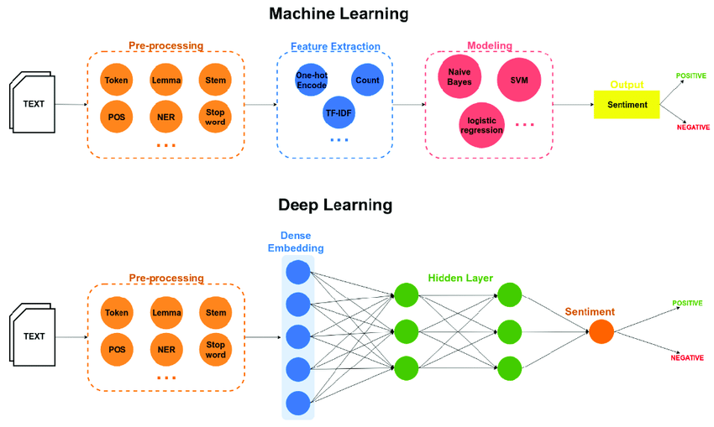
Classification vs Sentiment analysis

Slide 15
Classification vs Sentiment analysis
Classification: Basically what you do here: You make your system learn using existing data for all classes you have. Actually it will consider the basic features for each class, matches those classes with incoming item. The class, for which maximum features get matched, new item get classified in that class.
Sentiment analysis : Oh! Iphone 15 is so decent mobile. That shows positive sentiment. Your idea is fine, but i dont feel it is going to create any positive intact. That shows negative sentiment. Now a days machine learning techniques also being used for sentiment analysis.

Slide 16
SƠ LƯỢC WORD EMBEDDING
1. Khái niệm: Word Embedding là tên gọi chung của các mô hình ngôn ngữ và các phương pháp học theo đặc trưng trong Xử lý ngôn ngữ tự nhiên(NLP), ở đó các từ hoặc cụm từ được ánh xạ sang các vector số (thường là số thực). Đây là một công cụ đóng vai trò quan trọng đối với hầu hết các thuật toán, kiến trúc Machine Learning, Deep Learning trong việc xử lý Input ở dạng text, do chúng chỉ có thể hiểu được Input ở dạng là số, từ đó mới thực hiện các công việc phân loại, hồi quy,vv….
2. Các loại Word Embedding
Word Embedding được phân chủ yếu thành 2 loại:
Frequency-based embedding: Count Vector, TF-IDF Vector, Co-occurrence Matrix, GloVe (Global Vector)
Prediction-based embedding: Word2vec (CBOW, Skip-gram), GloVe, FastText
Notes:
https://d2l.aivivn.com/chapter_natural-language-processing-pretraining/index_vn.html
https://viblo.asia/p/so-luoc-word-embedding-gDVK2RAeKLj
https://www.geeksforgeeks.org/word-embedding-techniques-in-nlp/

Slide 17
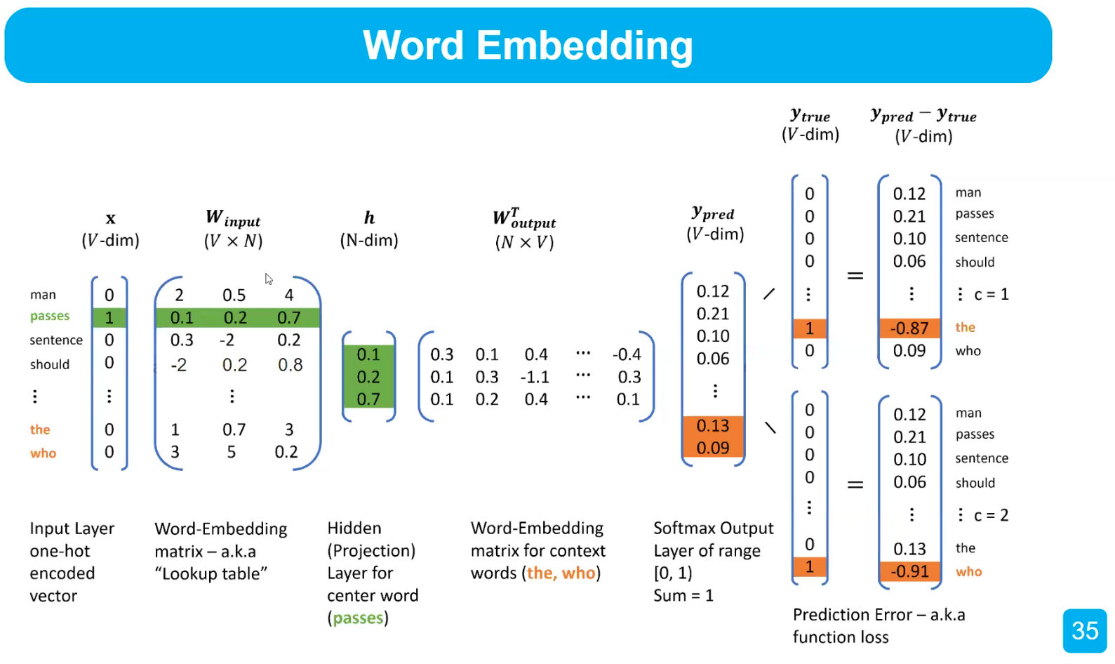
SƠ LƯỢC WORD EMBEDDING
Word2vec
Notes:
https://d2l.aivivn.com/chapter_natural-language-processing-pretraining/index_vn.html
https://viblo.asia/p/so-luoc-word-embedding-gDVK2RAeKLj
https://www.geeksforgeeks.org/word-embedding-techniques-in-nlp/

